Slide 1
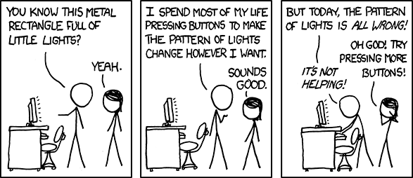
User Interface Design

Slide 2
UI Design: Week 1, Wednesday
Dr. Jillian Aurisano
Plan for today:
Reminders, course logistics
A bit more about design
Usability
Notes:
Here’s our plan for today:
First I’m going to introduce myself, so you know a bit about me
Then we are going to get to know each other, in Zoom breakout rooms. This will give us a chance to make sure that Zoom breakout rooms work, and we all know how to access them.
Then, I am going to walk through the structure, and plan for the course. I want to make sure everyone knows how the course will work, and what to expect, and also a bit about why the course is designed this way.
Then I am going to introduce the class, and what the class is about. Since this is a new class, and one of just a few classes in human centered computing here at UC, I wanted to give an overview of the topic.
Then I have an introductory activity, which we will do in breakout rooms, and which I think will help motivate the discussion on Wednesday, and getting into the meat of the class.

Slide 3
Course logistics
Syllabus:
Questions?
Homework:
Questions?
Project:
Questions?
Student hours:
After class most days- my office / outside the room near Starbucks?

Slide 4
Syllabus
Questions?

Slide 5
Homework
Getting started
Ok for portfolio page to also be github- just need to be able to add screenshots and document thoroughly
Other questions?
Hw1
Read tutorials
Optional- watch videos
Complete the coding activities
Focus on technical mechanics and basics, not creating a great design

Slide 6
Project 1
Let’s take a look…

Slide 7
Big picture: What is the ultimate goal in designing things
(in our case- designing user interfaces to computer systems)
“Ultimately, we are deluding ourselves if we think that the products that we design are the "things" that we sell, rather than the individual, social and cultural experience that they engender, and the value and impact that they have. Design that ignores this is not worthy of the name”.
— Bill Buxton
---------> “User experience”

Slide 8
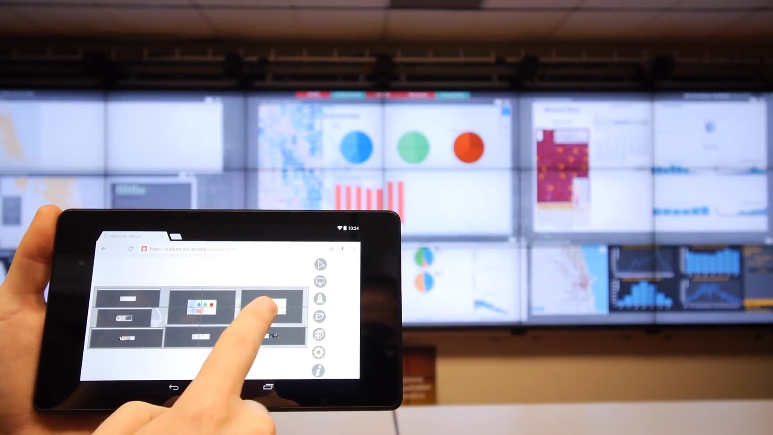
Remember this…. (Sage2)

Slide 9
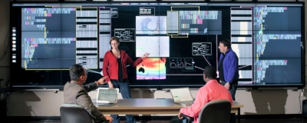
When I started graduate school…. Sage
Earlier version
My experience with it. …..

Slide 10
But….
I went to try to get people at a company (not my lab) to use it, while I did an internship
STRUGGLE!!!
Couldn’t figure out how to use it
Ran into little errors that discouraged them from continuing to use it
Had to install new software, multi-step installation -> barrier
Eventually, my experience helped us build a new version with a more usable interface
The experience of a computer system may be wonderful, but only if it is usable

Slide 11
Take-away
It if isn’t easy to use, no matter how great the experience is eventually (or for certain users), it won’t get used.
User experience is downstream of usability
Usability is a key component of building things that enable these amazing experiences with a computer system
So, let’s start with Usability!

Slide 12
What is usability?
Usability is an attribute that assesses how easy user interfaces are to use

Slide 13
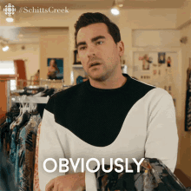
What is usability?
Usability is an attribute that assesses how easy user interfaces are to use

Slide 14
Let’s consider some examples of usability failures

Slide 15
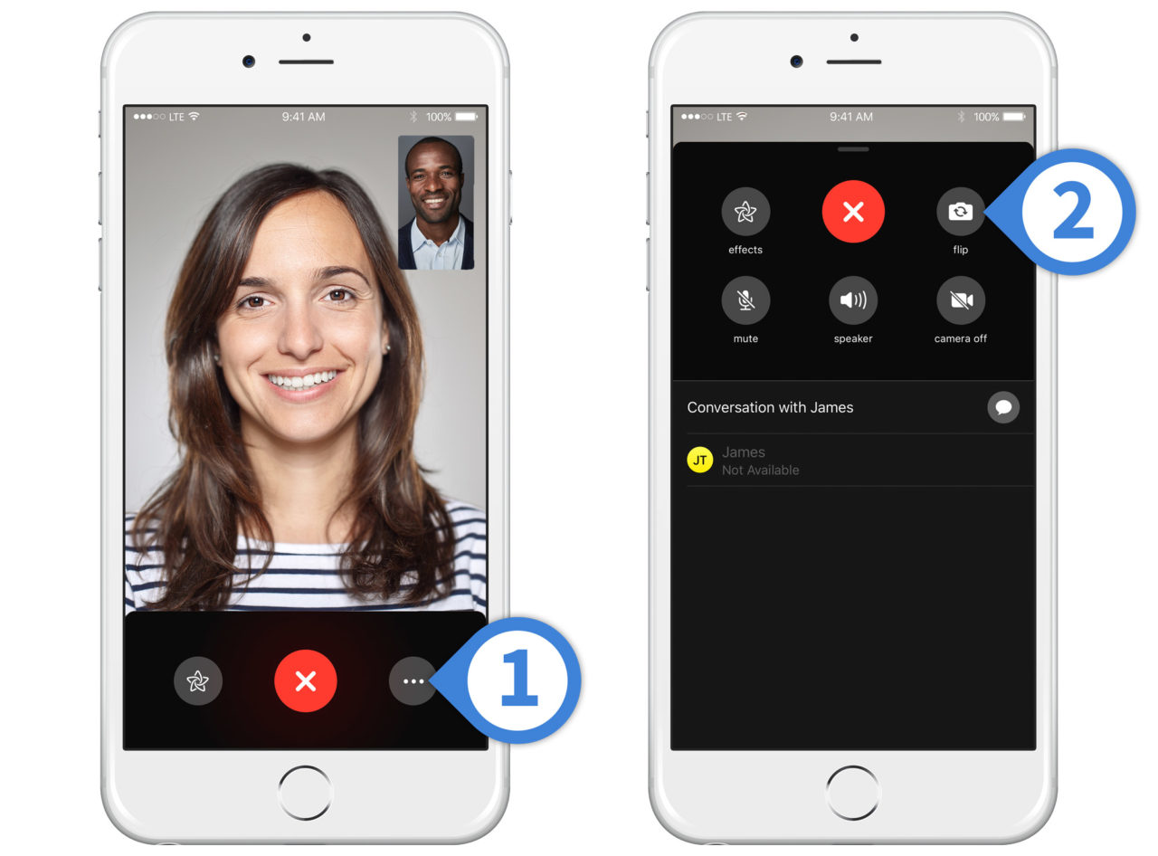
Even designers at Apple, can make less than fully usable designs
Facetime design iteration a few years ago
Problem arose with the ‘flip camera’ button
What might go wrong?

Slide 16
Even designers at Apple, can make less than fully usable designs
What might go wrong?
No immediate feedback on the action (camera view blocked)
What is the ‘X’ button? Close the menu? End the call? Confusing and too easy to initiate an action you didn’t intend
Designers at apple did this- why is it so hard to make a good design?

Slide 17
Why is UI design hard?
Why can’t we just make good designs?

Slide 18
Why is UI design hard?
You are not the user
Most software engineering is about communicating with other programmers, who may be a lot like you
UI is about communicating with the users who are NOT like you
Sidebar- Users are not designers. They may not be able to tell you what is wrong.
They know they are frustrated
They know they can’t accomplish their tasks.
But, we can’t expect them to diagnose the problem

Slide 19
Temptation: blame the user
You are the engineer, you know the requirements you were targeting, the features you wanted to enable
If users can’t use the UI, they must be…. (incompetent, inefficient, slow, lazy...)
I certainly had this temptation when I worked on Sage
Why can’t they just poke around and learn it?
Why are they giving up so quickly, without even trying?

Slide 20
Temptation: blame the user
The user is ALWAYS right- usability problems are the design’s fault

Slide 21
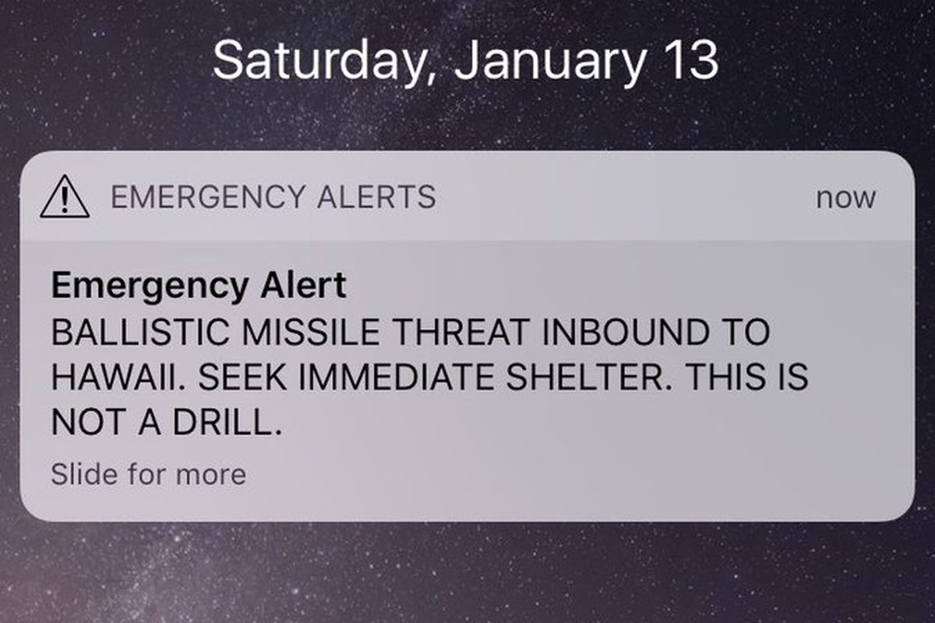
Hawaii Ballistic Missile Threat

Slide 22
Hawaii Ballistic Missle Threat example
Question we ask when something goes wrong is often “who messed up?”
“An employee pushed the wrong button” Governor David Ige
Response of the agency - blaming people
Fire the person who made the mistake
Require more training
Require higher standards in hiring
But is this the fault of a person?
https://www.fastcompany.com/90157153/don-norman-what-went-wrong-in-hawaii-human-error-nope-bad-design

Slide 23
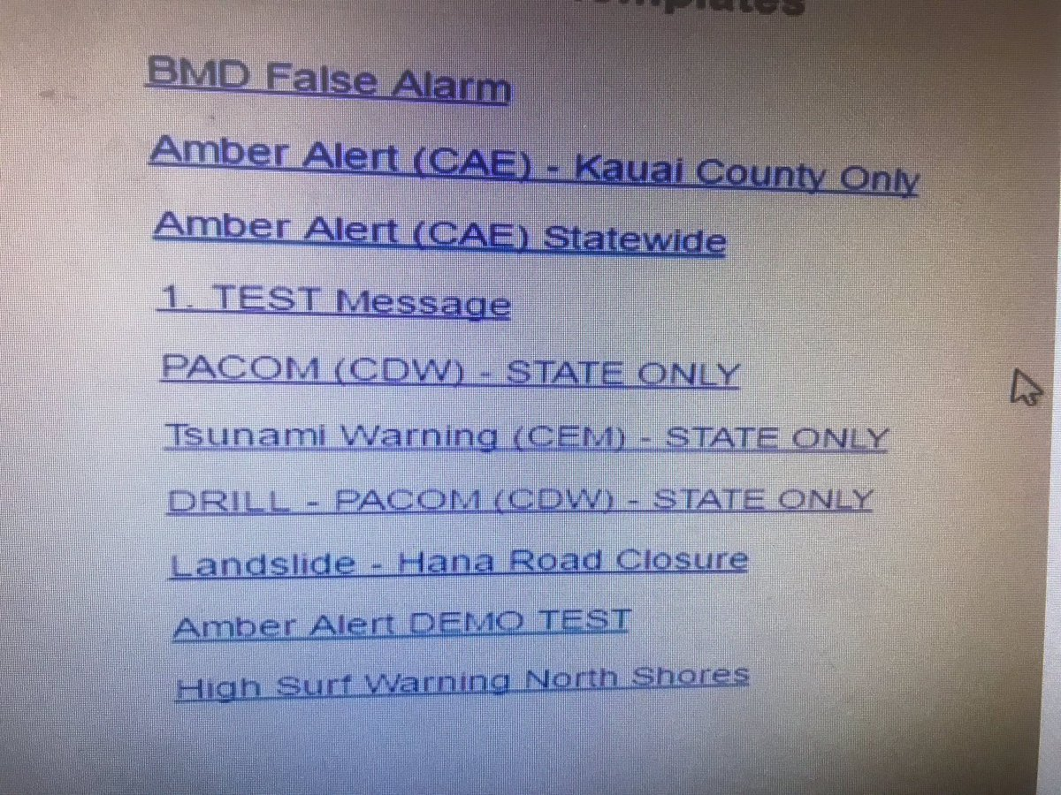
Hawaii threat system UI

Slide 24
Hawaii Ballistic Missile Threat example
But what is the root cause of the human error?
Poor design
The system is tested 2x’s a day, person doing the test selects from the list
They selected:
They were supposed to select:
Let’s fix it!!
Take a minute and brainstorm ways to fix it

Slide 25
Hawaii Ballistic Missle Threat example
Let’s fix it!!
Confirmation before sending for non-test messages (there was one… but this isn’t the best design…)
Test mode that has to be de-activated to get to the real messages
“Two-lock” system: two independent people must sign off
A way to correct the error immediately
And also, what about the visual design
Position, Color, Size, of these options

Slide 26

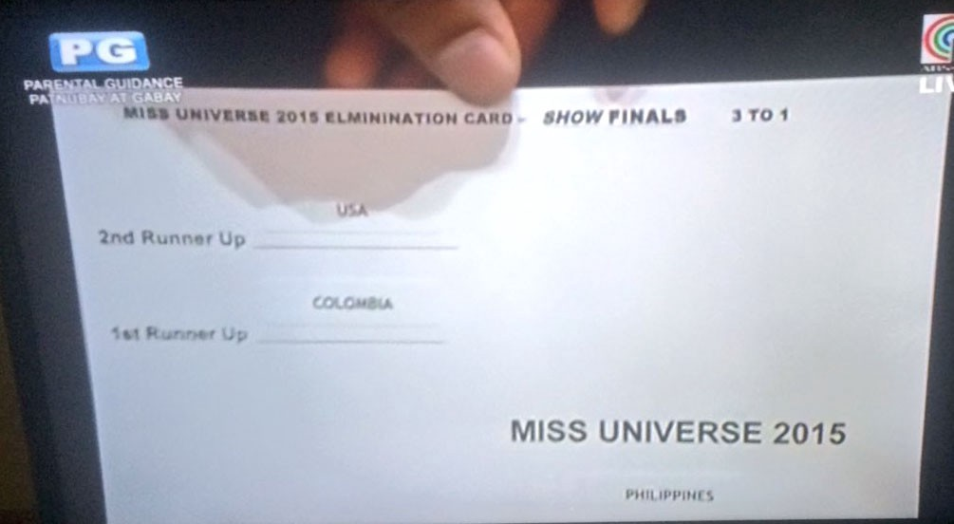
Similar example (less life threatening…)
Errors happen
But: Font, layout- terrible to direct the reader to the winner
Good design- minimize these errors

Slide 27
Usability vs Utility vs Usefulness
Sound similar….

Slide 28
Usability vs utility
Utility : do the features provided by the UI or computer system enable you to accomplish your task
Does the system have the features you need?
Usability: is how well users can take advantage of the UI’s functionality
Is it easy to get to these utilities?
Is the design useful?
Combination of Usability + Utility
It has the features you need, it has good features
You can use these features easily

Slide 29
Useful vs Usability vs Utility
Utility : do the features provided by the UI or computer system enable you to accomplish your task
Does the system have the features you need?
Usability: is how well users can take advantage of the UI’s functionality
Is it easy to get to these utilities?
Can we think of examples of:
Something that is usable, but is lacking in utility
Something that has utility, but is not particularly usable

Slide 30
Can we think of examples of….
Something that is usable, but is lacking in utility
Google photos to make photo collages of my kids at the same ages
Something that has utility, but is not particularly usable
Unix terminal

Slide 31
What is usability?
Usability is an attribute that assesses how easy user interfaces are to use

Slide 32
Other attributes of a system
Functionality
Performance
Cost
Security
Maintainability
Size
Reliability
Marketability
…..
Let’s focus for now on usability

Slide 33
Dimensions of usability
There are lots of formulations, but here’s one:
Learnability: is it easy to learn?
Efficiency: once learned, is it fast to use?
Errors/Safety: are errors few and recoverable?
Some other formulations include:
Memorability: When you come back to the design after a time away, how easy is it to re-establish proficiency
Satisfaction: How pleasant is it to use the design
Note: you can measure these qualities. We will learn about some ways in our evaluation learning modules

Slide 34
Questions to ponder…
Dimensions of usability:
Learnability: is it easy to learn?
Efficiency: once learned, is it fast to use?
Errors/Safety: are errors few and recoverable?
Do all of these dimensions matter equally all the time when designing something? Let’s come up with some examples where:
Learnability is the most important factor
Efficiency is the most important factor
Errors/Safety is the most important factor

Slide 35
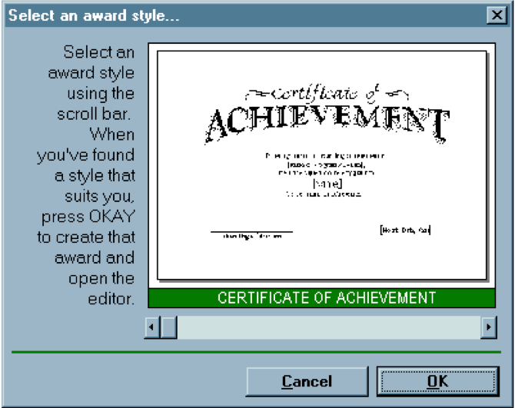
Let’s critique this example (Interface hall of shame)
Dialogue box prints award certificates
Presents the task of selecting a template for the certificate
Graphical interface
Mouse-interactions with common widgets (scroll bar, buttons)
What-you-see-is-what-you-get with the preview of the award shown
So, why is this perhaps not a great design?

Slide 36
Some comments….
Scrollbar problems:
Why is a scrollbar used for selecting a template? Scrollbars are for scrolling through continuous content.
Will a new user see the scrollbar and register that it is for selection? Will they skip the opportunity to select because of this?
No marks on the scrollbar- no indication of how many templates. How far do you drag it to get to a new template?
The ‘affordance’ of a scrollbar is continuous scrolling, not selection (think of our door handle which says ‘pull me’).
Will a frequent user remember how to find their favorite template that is 56% of the way into the scrollbar?
No shortcuts for frequent users
Help text:
So long!! If it needs a sign, probably bad design.
Press OKAY. Actual button: OK.
Why is it right justified?

Slide 37
Let’s redesign this….
Create a couple of alternative sketches
Task is selection of the template, seeing the output (“wysiwyg”)
Let’s see if we can do better

Slide 38
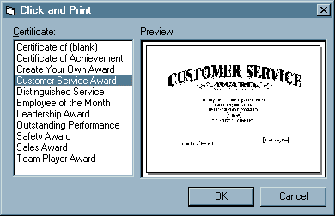
Redesign
Is this better?
Why?

Slide 39
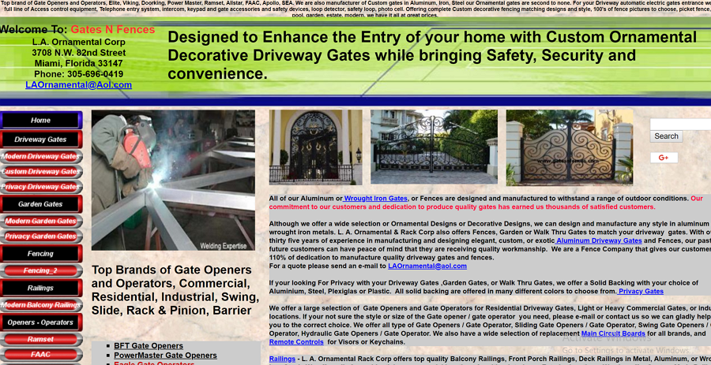

Slide 40
If the user can’t easily understand what they can do next, it is not very usable, and probably bad design
(and your user may go elsewhere for what they need)

Slide 41
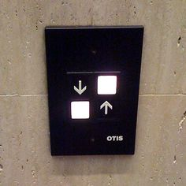
Example
Where do I press?

Slide 42
If the user is confused, it’s not very usable and probably bad design.

